Slide 1
Warehouse Management System

Slide 2
Background
The Warehouse management system is real time warehouse database that is capable of handling large inventories of organization.
Increase Efficiency and reduce errors that take place in their warehouse.
Useful to track the inventory of single store or manage the distribution of stock in multiple stores.

Slide 3
Drawbacks in existing systems
Lack of a centralized information system that automatically inputs and updates order information in database.
Inability to change the quantities or remove items from an order.
Doesn't have the ability to periodically provide notification when stock is low.

Slide 4
Proposed Project
Objectives:
Main goal of our project is to develop cost effective solution that fulfill requirement of all stakeholders.
To create and maintain In and Out transactions of single or multiple stores.
To generate billing details of In and Out transactions.
To provide notifications periodically when stock is low.

Slide 5
Target Customers
Suppliers
Retailers
Warehouse management administrator

Slide 6

Functionalities
Admin Module:
Login
Add products
Delete products
Edit/Update products
In and Out transactions
Billing of In/Out transactions
View Transactions
Generate Monthly report

Slide 7
Functionalities (contd.)
View Product and stock amount
View User profile
View product information
Notify low stock
Retailer/Supplier Module:
In and Out transactions
View stocks
Login

Slide 8
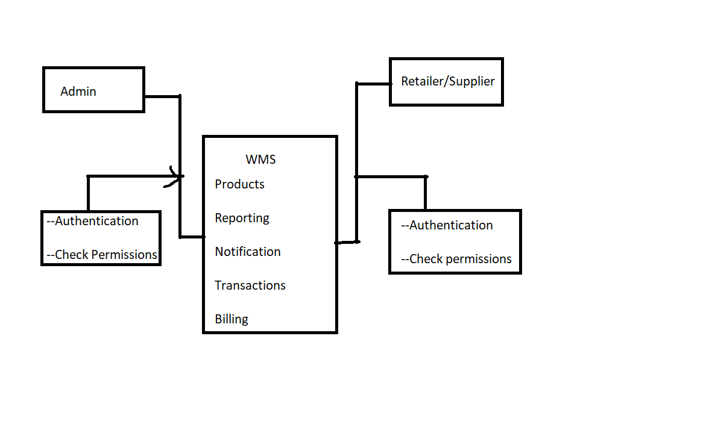
Design

Slide 9
Assumptions and Constraints
A Human mistake can cause the entire system to be inaccurate like issuing more stock than what is available in the warehouse(for this reason, certain operations will not be allowed).
Data is not stored in multiple databases to provide redundancy.

Slide 10
Tools and Resources
Tools:
Programming Language: Java, Spring Boot
IDE: Spring Tool Suite
Database: Mysql
Server: Apache Tomcat
UI Design: HTML, CSS, JavaScript
Resources:
https://dev.mysql.com/doc/
https://www.eclipse.org/downloads/
https://docs.oracle.com/en/java/

Slide 11
Profile
Name of team member 1:
Java Skill : Intermediate
Role: UI design and development , Backend development.
Name of team member 2:
Java Skill: Intermediate
Role: Database design, backend functionality design and implementation and documentation.

Slide 12
Thank you

